Slide 1
PRESENTATION…
TO CREATE A STATIC WEBSITE..

Slide 2

For creating static website …..
*We have to create one S3 bucket.
*A text document that we upload on bucket.

Slide 3

(Amazon web service)
AWS stands for Amazon Web Services. The AWS service is provided by the Amazon that uses distributed IT infrastructure to provide different IT resources available on demand. It provides different services such as infrastructure as a service (IaaS), platform as a service (PaaS) and packaged software as a service (SaaS)

Slide 4
Amazon S3…
Amazon Simple Storage Service (Amazon S3) is an object storage service offering industry-leading scalability, data availability, security, and performance. Millions of customers of all sizes and industries store, manage, analyze, and protect any amount of data for virtually any use case, such as data lakes, cloud-native applications, and mobile apps. With cost-effective storage classes and easy-to-use management features, you can optimize costs, organize and analyze data, and configure fine-tuned access controls to meet specific business and compliance requirements.

Slide 5
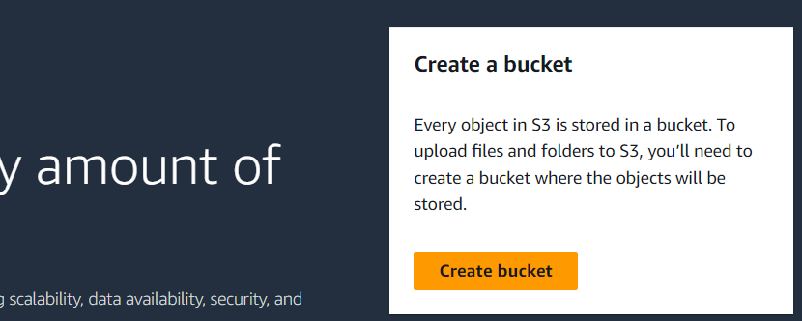
FOLLOW THIS STEPS TO CREATE A STATIC WEBSITE….
STEP 1:- Login to your AWS account.
STEP 2:- Search S3 from AWS services in the console page.
STEP 3:- Click on create bucket.

Slide 6
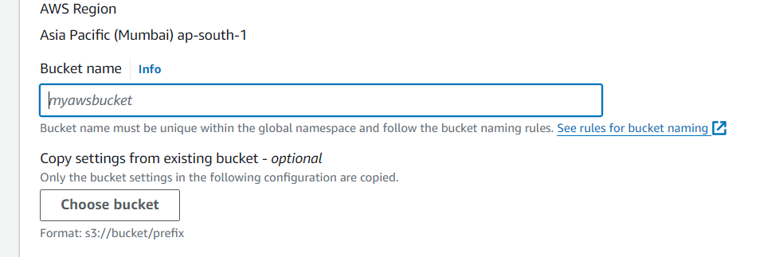
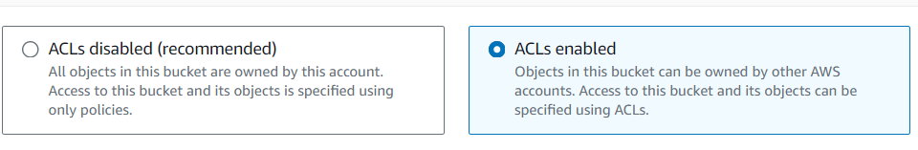
STEP 4:- Enter your bucket name.
STEP 5:- Put ACLs enable

Slide 7
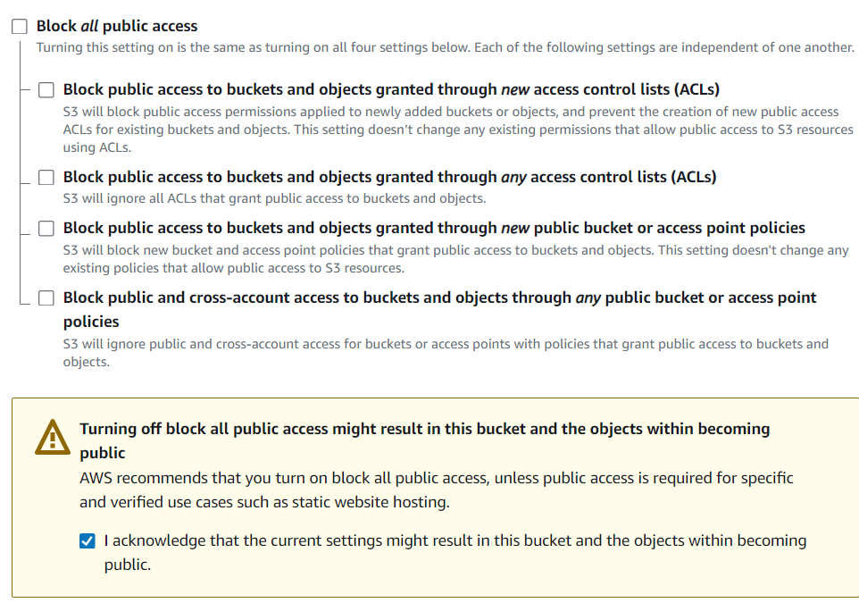
STEP 6:-And Turn off all the block public services
Leave other settings as default…
STEP 7:- click on create bucket given al last of the page.

Slide 8
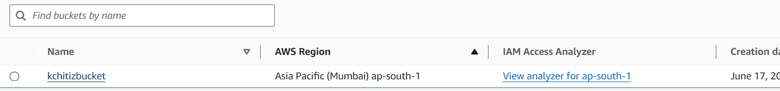
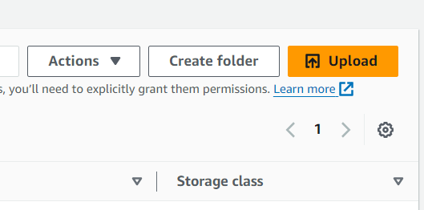
Your bucket is created
STEP 8:- click on your bucket name , then click on upload

Slide 9
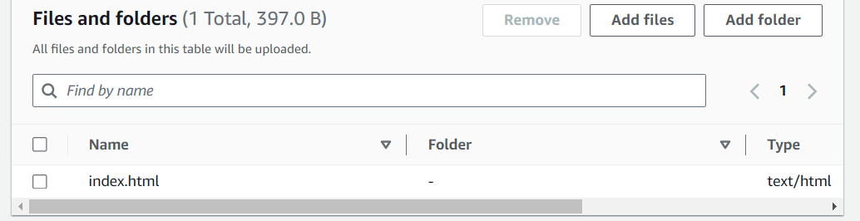
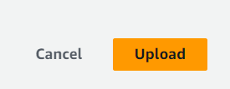
STEP 9:- now click on add files , here we have to add our text html document that we created on notepad.
Now click on upload.

Slide 10
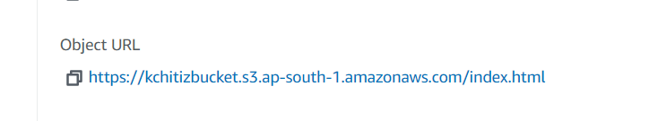
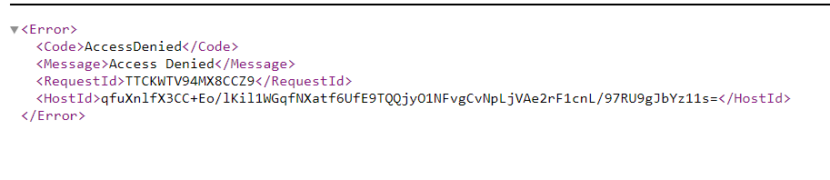
STEP 10:-Then move to properties , and open your URL link.
STEP 11:- After opening URL link , we get this error

Slide 11
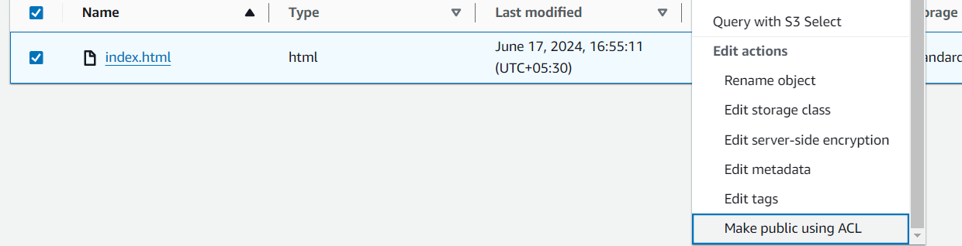
STEP 12:- Now select your document that uploaded on s3 bucket ,move to action then select make public using ACL Under action.
Click on make public , given at last of the page.

Slide 12
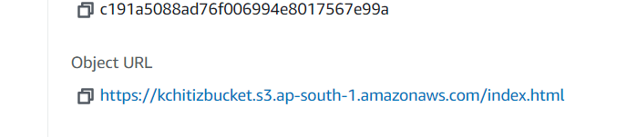
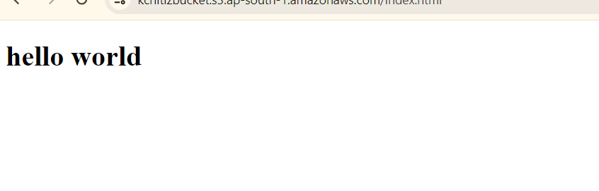
STEP 13:- Then move back to your uploaded file and open your URL link.
STEP 14:- After that , we have our final output here…

Slide 13
Thank You
Presented by:~Kchitiz Saxena

